Slide 1
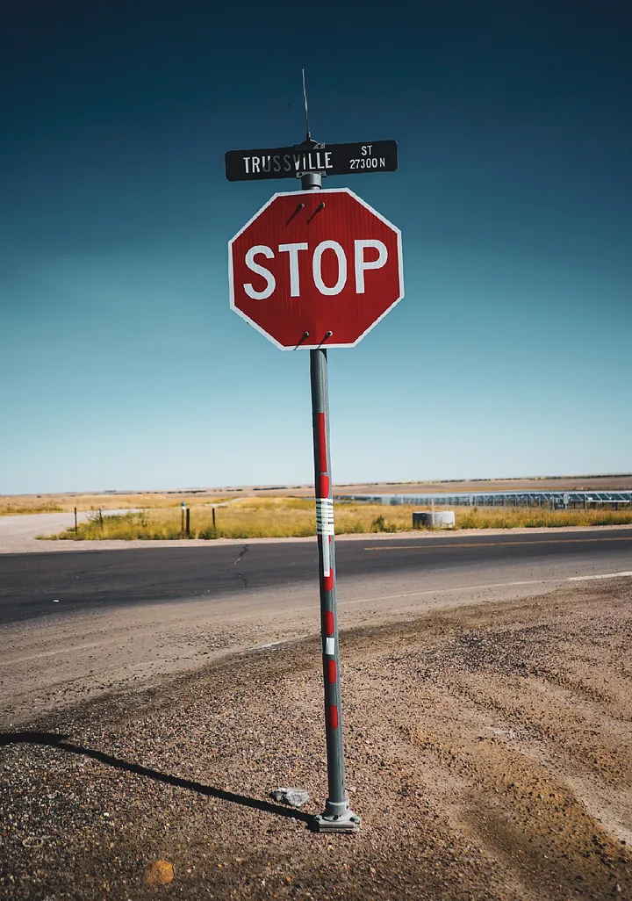
STOP SIGN DETECTION IN STREET IMAGES USING TRADITIONAL Machine Learning Algorithms
GROUP:08: MD. ABU YOUSUF NESHAD, MUBASSHIR SADAT, IRFAN SHAH MAYEEN AND AL AMIN

Slide 2
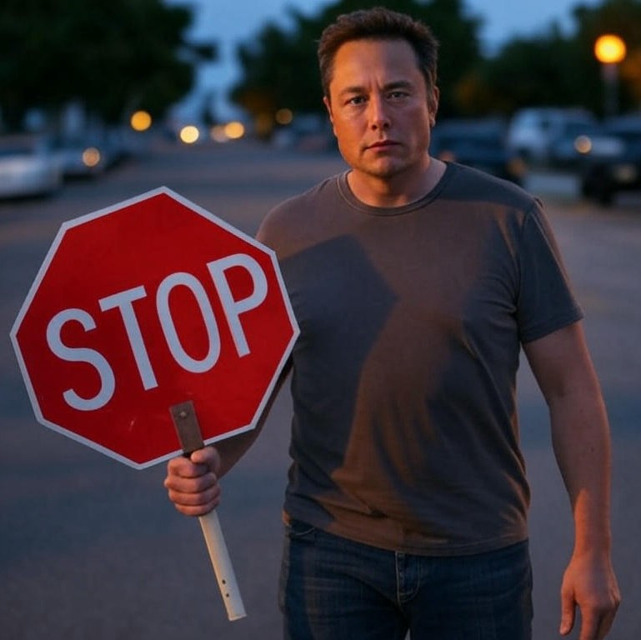
INTRODUCTION
Goal: Detect stop signs using traditional ML
Why: Enhance road safety, and traffic management
Methods: Traditional algorithms (e.g., SVM, Random Forests)
Progress: Data prep, model training, initial testing
Aim: Show practical value of traditional ML
GROUP:08: MD. ABU YOUSUF NESHAD, MUBASSHIR SADAT, IRFAN SHAH MAYEEN AND AL AMIN

Slide 3
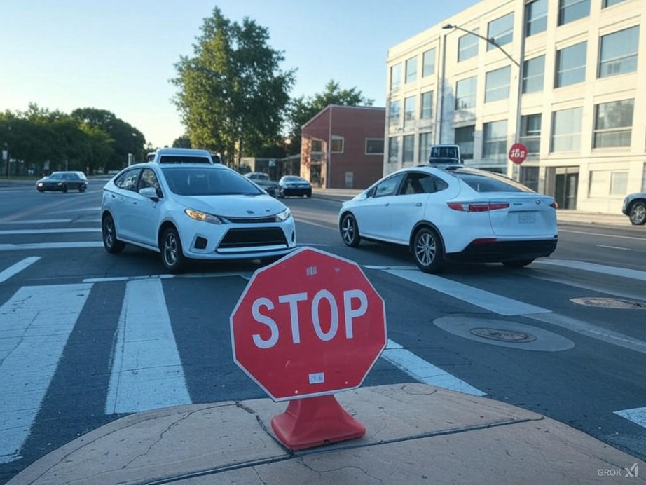
SIGNIFICANCE
Enhances road safety and autonomous navigation
Reduces traffic accidents at intersections
Leverages cost-effective, efficient machine learning
Ensures reliable stop sign detection
GROUP:08: MD. ABU YOUSUF NESHAD, MUBASSHIR SADAT, IRFAN SHAH MAYEEN AND AL AMIN

Slide 4
METHODOLOGY
DATA SET
PRE-PROCESS
MODEL TRAINING
TESTING
OUTPUT
GROUP:08: MD. ABU YOUSUF NESHAD, MUBASSHIR SADAT, IRFAN SHAH MAYEEN AND AL AMIN

Slide 5
DATASET & PREPROCESSING
Dataset: 100 street images (50 stop signs, 50 non-stop signs)
Preprocessing: Resized to 64x64 pixels, grayscale for HOG
Feature Extraction: HOG for edges, optional LBP, colour histograms
Data Split: 70% train, 10% validation, 20% test for CNN and MLP.
80% train, 20% test for other models.
Purpose: Uniform data for robust model training
GROUP:08: MD. ABU YOUSUF NESHAD, MUBASSHIR SADAT, IRFAN SHAH MAYEEN AND AL AMIN

Slide 6

MODEL TRAINING
Support Vector Machine (SVM)
Multi-Layer Perceptron (MLP)
K-Nearest Neighbors (KNN)
Catboost Classifier
Random Forest Classifier
Gradient Boosting
XGboost
CNN
GROUP:08: MD. ABU YOUSUF NESHAD, MUBASSHIR SADAT, IRFAN SHAH MAYEEN AND AL AMIN

Slide 7
MODEL TESTING
Performance Metrics:
Accuracy: (TP + TN) / Total
Precision: TP / (TP + FP)
Recall: TP / (TP + FN)
F1 Score: 2 * (Precision * Recall) / (Precision + Recall)
Confusion Matrix: Visualised for TP, TN, FP, FN
GROUP:08: MD. ABU YOUSUF NESHAD, MUBASSHIR SADAT, IRFAN SHAH MAYEEN AND AL AMIN

Slide 8
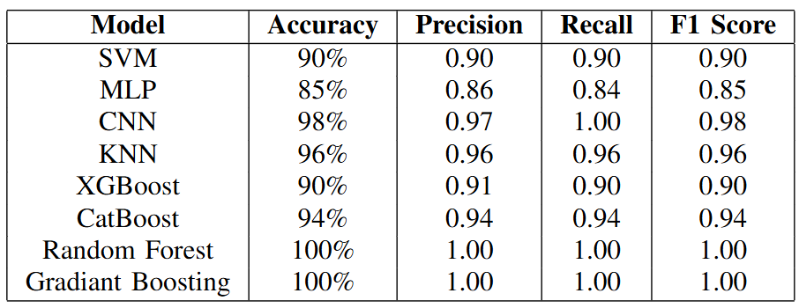
RESULTS
GROUP:08: MD. ABU YOUSUF NESHAD, MUBASSHIR SADAT, IRFAN SHAH MAYEEN AND AL AMIN

Slide 9
CHANLLENGES
Limited & Fixed Dataset
Lack of Night-Time Images
Angle & Perspective Issues
Occlusions & Visual Noise
Accuracy not stable
GROUP:08: MD. ABU YOUSUF NESHAD, MUBASSHIR SADAT, IRFAN SHAH MAYEEN AND AL AMIN

Slide 10
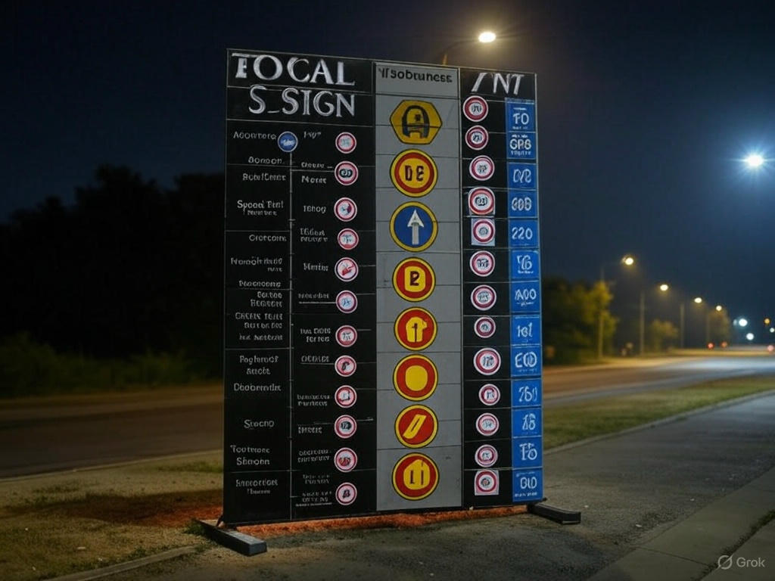
FUTURE WORK
Compare performance: accuracy, speed, robustness
Identify best model for real-world use
Optimize system for practical deployment
Improve night detection with infrared data
Expand to detect other traffic signs, like yield or speed limits.
GROUP:08: MD. ABU YOUSUF NESHAD, MUBASSHIR SADAT, IRFAN SHAH MAYEEN AND AL AMIN

Slide 11
CONCLUSION
Built stop sign detection with traditional ML
Initial results show effectiveness
Plan: Test more models, improve accuracy
GROUP:08: MD. ABU YOUSUF NESHAD, MUBASSHIR SADAT, IRFAN SHAH MAYEEN AND AL AMIN

Slide 12
THANK YOU

Slide 13
